Slide 1
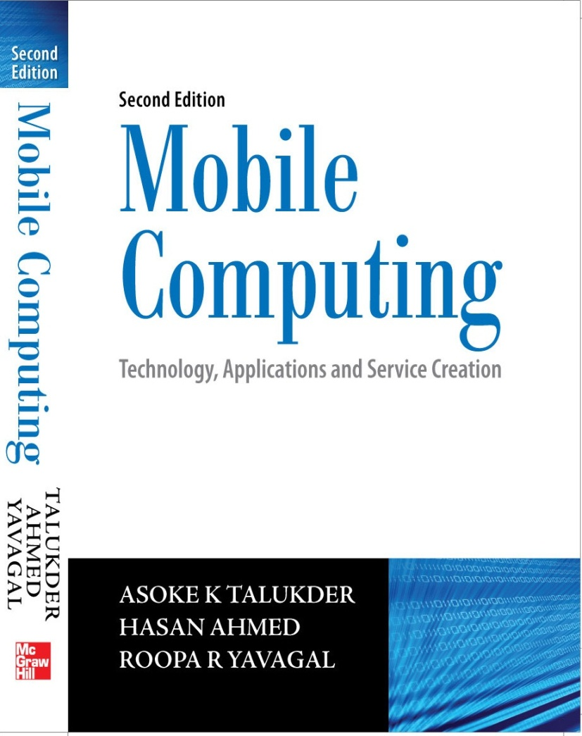
Notes#5
Java2 Micro Edition (J2ME)

Slide 2
Why Java?
Cross between a compiled and an interpreted language.
Java program runs on any Java Virtual Machine (JVM) irrespective of the computer or operating system, the virtual machine is running on.
Sun’s new mantra ‘Everyone, Everything, Everywhere, Every Time’ for Java holds successful.
Today, millions of developers worldwide are writing Java applications ranging from embedded mobile systems, to desktop computers, to large servers.

Slide 3
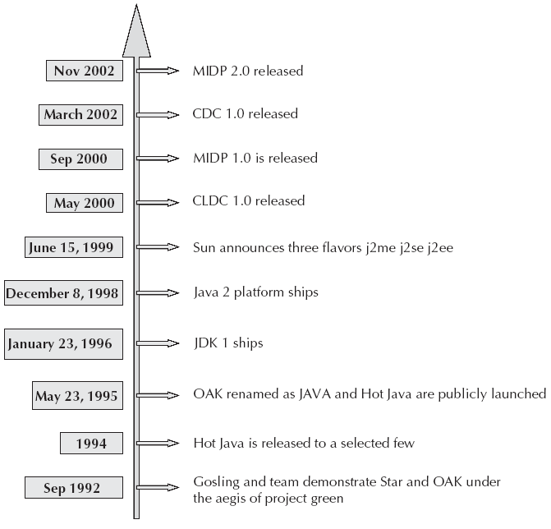
Timeline for Java and J2ME

Slide 4
Mobile Applications
Ones that are device resident, i.e., those that utilize exclusively the device resources and do not interact with any other applications outside except may be while being downloaded or installed.
The second type are the network enabled applications. The real potential of this kind of application is derived from the fact that it can connect to other devices across networks and perform tasks ranging from simple e-mail to complex monetary transaction.

Slide 5
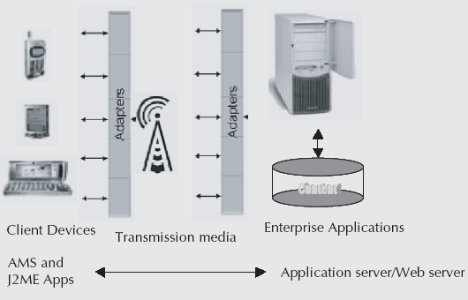
Mobile Application Architecture

Slide 6
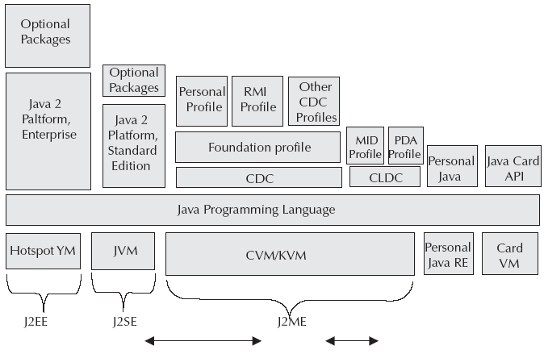
A three prong approach to Java

Slide 7
Java2 Micro Edition (J2ME)
The biggest challenge for J2ME was to specify a platform that could support a consistent set of services across a broad spectrum of devices with a large multitude of capabilities.
To be able to support the large brood of devices, a modular structure was essential. The designers of J2ME came up with a concept of configurations and profiles towards achieving this goal. The primary differentiators are computing power, power supply and I/O capabilities.
J2ME is a complete Java runtime environment consisting of a JVM (Java virtual machine), a set of Core Java runtime classes and a set of supported API (Application Programming Interface).

Slide 8
J2ME
To avoid fragmentation and a deluge of incompatible platforms, J2ME defines only two configurations representing the two distinct categories of devices.
The first category is devices that have superior UI facilities higher computing power and are constantly connected. These implement the Connected Device Configuration (CDC). For example, set top boxes, Internet TVs, Internet enabled screen phones, high end communicators and car entertainment/navigation systems.
The second being personal, mobile information devices that are capable of intermittent communications. These implement the Connected Limited Device Configuration (CLDC) in use for mobile phones, two-way pagers, PDAs and organizers.

Slide 9
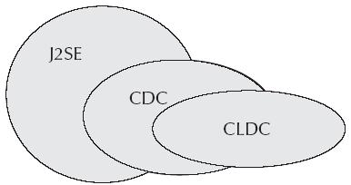
J2SE, CDC and CLDC

Slide 10
J2ME
Applications are built on top of the profile.
They can use only the class libraries provided by these two lower-level specifications.
Profiles can be built on top of one another.
A J2ME platform, however, can contain only one configuration.
By providing a common minimum platform, J2ME configurations and profiles enable creation of these custom editions in a structured way.

Slide 11
Connected Device Configuration (CDC)
CDC is a configuration for high end devices with larger memory, in the range of 2 MB or more, providing connectivity through some kind of network and some UI support.
CDC is a superset of the Connected Limited Device Configuration (CLDC) and is quite close to a conventional Java 2 Standard Edition (J2SE) runtime environment.
CDC specification defines a full-featured JVM, called the CVM, a subset of the J2SE 1.3 classes and APIs introduced in the CLDC.
CDC defines three profiles: Foundation Profile, Personal Profile and Remote Method Invocation (RMI) profile.

Slide 12
Foundation Profile
Foundation profile is targeted at devices supporting a strong network but do not provide any User Interface (UI).
Essentially, it does the ‘useful’ work.
It is also used as a base by other profiles, which then build on its functionality by adding UI and other components.

Slide 13
Personal Basis Profile
J2ME Personal profile is a reincarnation of the Personal Java Application Environment suitably modified to fit into the J2ME environment.
Built on top of the Foundation Profile, it is backward compatible with Personal Java 1.1 and 1.2.
It caters to devices that enjoy reliable and constant Internet connectivity and rich GUI.

Slide 14
J2ME Profile
J2ME Remote Method Invocation profile provides support for RMI across applications.
It is built on top of the Foundation Profile and uses TCP/IP as the underlying connection protocol.
It is interoperable with the Java 2 Standard Edition (J2SE) RMI API 1.2 and higher.

Slide 15
Connected Limited Device Configuration (CLDC)
CLDC is meant for low end, intermittently connected, battery-operated devices.
A CLDC device is characterized by the following capabilities: a minimum of 128 to 512 KB for the platform, a 16-bit or 32-bit low end processor and a low bandwidth network with intermittent connectivity.
CLDC runs on KVM, which is a highly optimized JVM for resource constrained devices. It includes just the basic classes from the java.lang, java.io and java.util packages with a few additional classes from the new javax.microedition.io package.
CLDC defines two profiles: Mobile Information Device Profile (MIDP) and Personal Digital Assistant Profile.

Slide 16
MIDP Profile
Provides classes for writing downloadable applications and services that are of interest to the consumer. For example games, commerce applications, personalization services, etc.
MIDP profile requires the devices to have a minimum of 512K for the platform, intermittent connectivity to some type of wireless network, limited User interfaces and some kind of input mechanism.

Slide 17
PDA Profile
PDA Profile lies on top of the CLDC specification.
It provides user interface and data storage APIs for devices with the following resource constraints: minimum 1000K for the platform, battery powered low power devices, good UI capability with a resolution of 128x128 pixels and depth of 1 pixel, a touch screen, and or character input mechanism in the form of a T keypad or a full qwerty keyboard and an intermittent and low bandwidth two way connectivity.

Slide 18
MIDlet Model
A MIDP application is called a MIDlet and is a take-off on the traditional Applet.
MIDP application or MIDlet sits atop the MIDP which in turn requires the services of the CLDC and the VM below it. Finally, it is the device hardware that executes instructions on behalf of the software layers above.
The browser’s equivalent in the MIDP world is called Application Management Software (AMS). It is a device resident software and all MIDlets run within the context of an AMS.
A set of MIDlets can be grouped together into a MIDletsuite. Other than managing the MIDlet, the AMS is also responsible for Application Provisioning and Application removal.

Slide 19
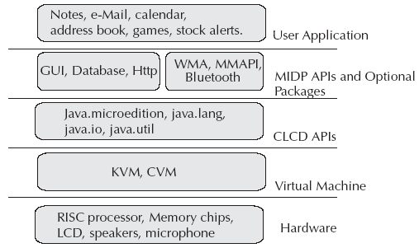
Typical MIDP Application

Slide 20
Provisioning in MIDlet
Provisioning is the process of application discovery, download and installation. The process includes appropriate user interactions, including payment authorizations. It is a 6 step process:
Search
Retrieving the descriptor file which includes the application details, checks for version and compatibility issues
Proceeding to download the appropriate jar file
Once the download is completed the AMS is called to install
VM is launched
Applications are launched

Slide 21
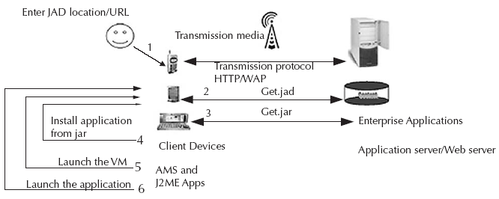
Provisioning a MIDP Application

Slide 22
MIDlet Life Cycle
MIDlet has three states. The life cycle methods allows the AMS to notify and request MIDlet state changes.
On being activated by the AMS, the MIDlet is constructed but is still inactive. Now, the MIDlet is in a paused state.
Once constructed, the AMS initializes and activates the MIDlet. MIDlet’s now changes to active state. If the initialization fails, state is changed to the destroyed.
A transition from active state to the paused state is initiated by the AMS or by the MIDlet itself. In this state, a MIDlet should release all its resources.
A MIDlet can be destroyed from either active or paused state.

Slide 23
Three states of MIDlet
paused: The MIDlet is constructed but inactive
active: The MIDlet is active and can process requests
destroyed: The MIDlet has been destroyed and is ready for garbage collection

Slide 24
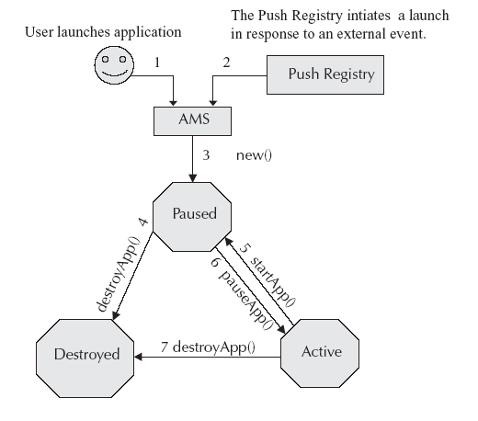
MIDlet Life Cycle

Slide 25
MIDlet Event Handling
User interactions generate events. These could be screen inputs, item state change and handset data update.
MIDP event handling mechanism is based on a listener model. It provides interfaces for each of the events mentioned above. These interfaces implement callback methods, which in turn invocate application defined methods. These methods perform the desired functions in response to events.

Slide 26
Security Considerations in MIDP
Security considerations are of different types namely application security, data security and communication security.
MIDP 1.0 implemented a strict sandbox for all applications.
Thus, APIs prevented access to sensitive device capability assuring application security.
Only MIDlets within the same MIDlet suite can access record stores belonging to the suite i.e. created by the MIDlets in the suite.

Slide 27
Application Security
Applications belong to either the trusted domain or the un-trusted domain.
A MIDlet suite that is not trusted will be run in un-trusted mode. Each domain is associated with a domain policy that defines the requirements for a MIDlet to be considered as trusted.
A domain policy defines a set of permissions “allowed” and “user” that can be granted to the MIDlet.

Slide 28
Recordstore Security
MIDP 2.0 allows for shared record stores. Sharing is defined by the MIDlet suite at the time of creation. Access controls are enforced when RecordStores are opened.

Slide 29
Communication Channel Security
Secured networking was introduced in MIDP 2.0 with the introduction of HTTPS (Secure HTTP).
Another level of protection is the secure domains discussed above. All protocols have to initiate a request through a call to javax.microedition.io.Connector.open(…). The permissions are granted individually to protocols.
It is not mandatory for all devices to implement all protocols, if implemented, the security framework specifies the naming of permissions based on the package and class name.

Slide 30
Security of PushRegistry
PushRegistry is also uses the security framework and permissions.
Only MIDlet suites having the javax.microedition.io.PushRegistry permission can register for a Push based launch.

Slide 31
Optional Packages
To enhance J2ME capability, we have optional packages. An optional package is a set of APIs to support additional features that don’t really belong in one specific configuration or profile. Bluetooth support, for example, is defined as an optional package.
Optional packages prescribe their own minimum requirements and are dependent on a particular configuration and one or more profiles. There are many optional packages in development, including JDBC Optional Package, Wireless Messaging API (WMA), Mobile Media API (MMAPI), RMI Optional Package and a host of other APIs.

Slide 32
Mobile Related JSRs
As technology advances, the Java community is making sure that Java remains up-to-date and supports these advancements. This is done through Java Specification Request ( JSR).
JSR extends the Java framework to support both current practices and advanced applications development.
Being the offspring of Java Community Process ( JSP), JSRs mainly cater to areas like J2EE ( Java2 Enterprise Edition), J2SE ( Java2 Standard Edition), OSS, XML, JAIN and J2ME ( Java2 Micro Edition). There are more than 180 released JSRs and many are still in the development phase.
There are 82 JSRs in Java that can be directly related to J2ME. These JSRs address mobile computing and wireless technologies.

Slide 33
Latest in J2ME
J2ME’s latest offering is JavaME 3.0 SDK. This flavor of J2ME is highly integrable with third party applications and framework. This ensures J2ME truly inheriting Java’s “High Performance–Cross Platform” legacy.
Adding to this, freeware world makes its contribution in respect of applications, games, emulators, embedded devices add-ons, plug-ins, APIs, tutorials, etc. One recent and striking capability of J2ME is its integration with Android. This helps developers to write managed code in Java, controlling the device via third-party-developed Java libraries.
One very recent development is the availability of JavaFX application platform, also known as JavaFX Mobile, and its high degree of affinity of integration with J2ME.

Slide 34
Latest in J2ME
www.java.sun.com – The official source for J2ME development and latest releases.
www.j2mepolish.org – J2ME Polish is a suite of tools and technologies aimed at mobile developers and companies within the mobile space.
http://java.sun.com/javafx/1/tutorials – This is a good resource for JavaFX.
http://www.netmite.com/android/ – This provides a lot of developer’s material for integrating J2ME applications with Android.
http://netbeans.org/features/javame/index.html – A lot of developer’s stuff can be found when you go to access NetBeans IDE.

Slide 35
J2ME Capabilities
J2ME capabilities are quite restrictive from a Java developer’s perspective but for someone who has already worked with Sim Tool Kit (STK) or JavaCard technologies, it is a luxury.
The configurations have been formed keeping in mind the limitations of the devices.

Slide 36
What J2ME does handles
Basic Java: Object, Class, Runnable, String, System,Thread,Throwable java.lang.
Data Types: Int, char, String, Stringbuffer
Utility classes Stack, Vector, Hashtable, Enumeration, Date,Calendar, random numbers java.util
I/O Stream classes (java.io)
Operations: integer math,abs, min, max java.lang.Math
Exceptions limited list of standard exception classes

Slide 37
What J2ME does not handles?
Floating point: Most small CPUs don’t have on-chip floating point and MIDP doesn’t include it.
Class loader: There is no option for the developer to choose the class loader. It is the responsibility of the default loader.
Finalization doesn’t exist. The developer is responsible for cleaning up before the object deletion takes place.
JNI: There is no standardized calling convention or hardware profile and hence doesn’t make much sense to native support. This is also a security threat.
Reflection is not included in J2ME.

Slide 38
What does J2ME not handles?
Error handling: a specific set of exceptions is generated. Other errors are left to the device manufacturer to handle as they deem fit.
High-level APIs: Heavy weight GUI APIs, Swing and AWT, are replaced by more appropriate APIs.
File handling: Due to memory constraints, there is no interface for reading or writing persistent files. We have only a mechanism called Record Management System (RMS) which provides a means for creating persistent data records.

